Slide 1

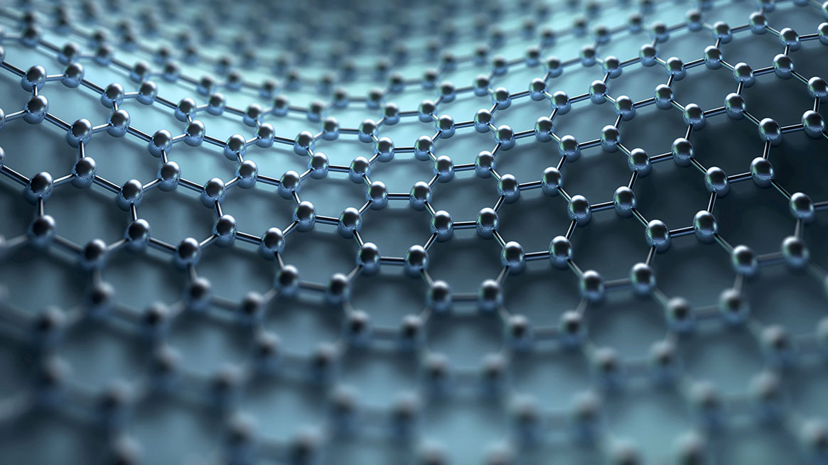
Chapter 1 Introduction to Computer Systems
KEVIN 2025/09/15
Notes:
It's time for class!: (上課時間到了！)
Ten minutes after class 下課十分鐘
下課了。 That's all for today.

Slide 2
Chapter 1 Introduction to Computer Systems
1.1 What is a computer?
1.2 Types of Computers
1.3 History and evolution of computer development
1.4 Moore's Law
1.5 Architecture of the operation of a computer system
1.6 Computer Hardware Structure
1.7 The concept of instruction set computers
1.8 Timeline of important development of modern computers

Slide 3
1.1 What is a computer
The calculator is:
A machine that accepts specific instructions and executes them in a predetermined manner or logic. In actual operation, the computer will accept some information, process it with pre-designed rules by people, and then output or store the results.
Two major features of computers:
1.Precise
2.Fast
Notes:
Precise 精確

Slide 4
1.1 Types of computers
Classification according to scope of application
Classification by the type of data being processed
Classification according to processing energy
Classification according to usage occasion
Notes:
Elasticity 彈力

Slide 5
1.2.1 Classification according to scope of application
General purpose computer
The "computer" that most people are more familiar with Install the software you need for different tasks or purposes
Great elasticity
Special purpose computer
A computer designed to provide some kind of special function
Neither hardware nor software can be changed arbitrarily
Fulfill specific purposes

Slide 6
1.2.2 Classification by the type of data being processed
digital computer
Process digitized data
analog computer
Handle continuous data that is not digitized
hybrid computer
A computer designed based on the data processing
principles of the above two types of computers
(i.e., digital computers and analog computers).

Slide 7
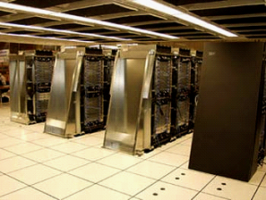
1.2.3 Classification according to processing energy
Super Computer
Extremely demanding speed requirements and extremely large data volumes are required for computing needs
Extremely demanding speed requirements and extremely large data volumes are required for computing needs
deep blue 、CRAY-2

Slide 8
1.2.3 Classification according to processing energy
mainframe computer
Fast speed, huge memory capacity, and many functions
Most of them are located in the computer room and are used by multiple people through terminals or networks
Host computer
medium computer
It is inferior in energy to mainframes, but it is already quite powerful

Slide 9
1.2.3 Classification according to processing energy
mini computer
Small computers, which are one size smaller than medium-sized computers
HP3000、VAX-11、PDP-l1
The main market is the laboratories of small businesses or academic units
micro computer
The computing core is one or more microprocessors
The most commonly used computer type (PC) is the most widely used and economical type
It can also be divided into desktop, laptop, handheld type, etc

Slide 10
1.2.4 Classification according to usage occasion
server
Larger computers can be used by multiple users at the same time through terminals or networks.
It is used to handle large amounts of computing that personal computers cannot handle, or to manage public software and hardware resources, and to provide the services required by individual users.
This type of computer is generally placed in the computer room, and a dedicated person is responsible for maintenance and management

Slide 11
1.2.4 Classification according to usage occasion
It is not limited to computers that can only be placed on the table, in fact laptops are also classified as such.
desktop computer
Also known as a personal computer, it is usually placed in a personal work environment where users can easily access its hardware, most commonly on a desk or desk.
It is not limited to computers that can only be placed on the table, in fact laptops are also classified as such.
With an independent system, it can not only operate independently, but also connect to the Internet to share a wider range of resources.

Slide 12
1.2.4 Classification according to usage occasion
embedded computer
A computer system developed for a specific purpose, usually installed in certain devices, to control those devices or to provide the required services.
Embedded computers are usually smaller in size and cannot arbitrarily change their hardware architecture or software system.
Embedded computers typically only perform specific operations, so they can speed up those operations without considering additional features or performance.

Slide 13
1.3 History and evolution of computer development
The origin of electronic computers - the era of mechanical types（1642 ~1945）
The first generation of computers - the era of vacuum tubes（1946~1953）
The second generation of computers - the transistor era（1954~1965）
The third generation of computers - the era of integrated circuits（1965~1980）
The fourth generation of computers - VLSI ultra-large integrated circuit era （1980~????）

Slide 14
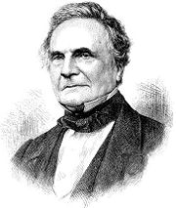
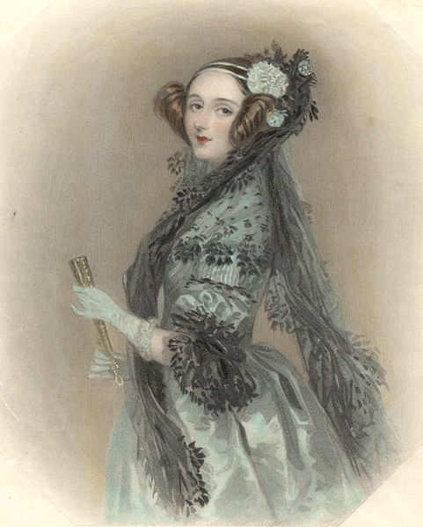
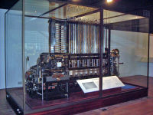
1.3.1 The origin of electronic computers - the era of mechanical types （1642~1945）
Charles Babbage
Ms. Ida
Differential machine

Slide 15
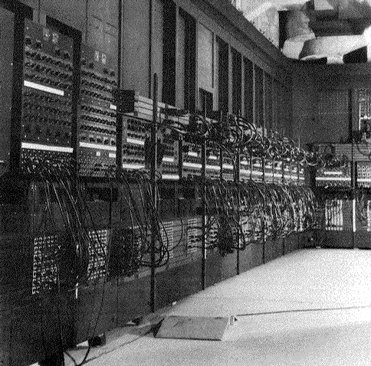
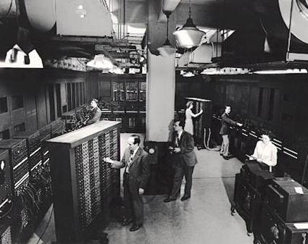
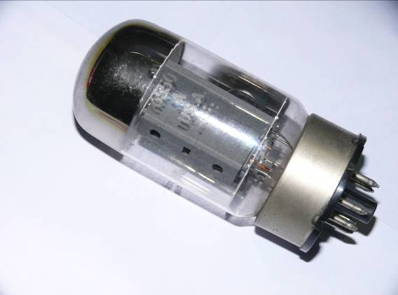
1.3.2 The first generation of computers - the era of vacuum tubes （1946~1953）
vacuum tube
Eckert&Mauchly
ENIAC calculator

Slide 16
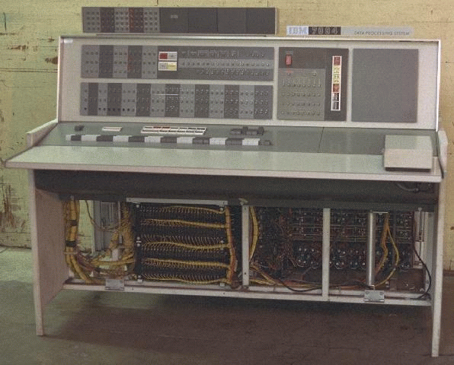
1.3.3 The second generation of computers - the transistor era （1954~1965）
IBM On the Model 7094 computer

Slide 17
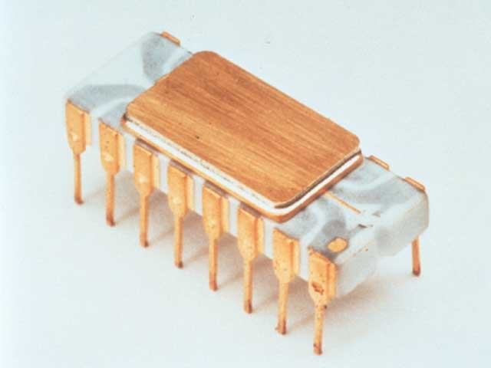
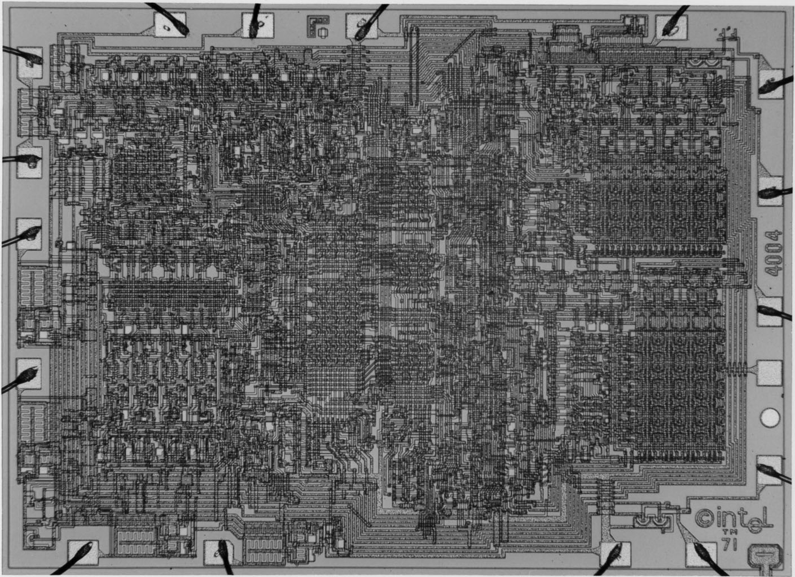
1.3.4 The third generation of computers - the era of integrated circuits （1965~1980）
Intel 4004 Processor appearance
Intel 4004 Processor micrograph

Slide 18
1.3.5 The fourth generation of computers - VLSI ultra-large integrated circuit era （1980~????）
The various computer processors we see today are all products after the VLSI era
At present, the development of integrated circuits has further entered the era of the so-called nanometer.
More precise processes, smaller chips, and more transistors will surely bring us more powerful and efficient processors.

Slide 19
1.4 Moore Law
Intel 處理器 | 8086 | 80286 | 386 DX | 486 DX | Pentium | Pentium Pro | Pentium Ⅱ | Pentium Ⅲ | Pentium 4 | E8600 | i7_965
Transistors number(K) | 29 | 120 | 275 | 1180 | 3100 | 5500 | 7500 | 24000 | 42000 | 410000 | 820000
The number of transistors in an Intel processor

Slide 20
1.4 Moore Law
Intel processor | 8086 | 80286 | 386DX | 486DX | Pentium | Pentium Pro | Pentium Ⅱ | Pentium Ⅲ | Pentium 4 | E8600 | i7_965
Clock Freq (MHz) | 10 | 12.5 | 33 | 50 | 233 | 200 | 300 | 1000 | 1700 | 3160 | 3200
The clock growth process of Intel's chip clocks of various generations

Slide 21
1.5 The architecture of how computer systems work
Normally, computer systems can be divided into seven levels according to the logic of their operations, and each layer can be used independently to fully describe the function or operation of the computer.
There is a direct correspondence between the previous or next layers ：The upper level delivers the work undertaken to the lower level, while the lower level can realize the functions or operations required by the upper level.
Changes in either layer will not affect the content of the upper and lower layers. This design feature is called the layer law.

Slide 22
1.5.1 A model with a seven-tier architecture
The seven-layer architecture of computer systems

Slide 23
1.5.2 Level 7: "User" layer
The user layer is a layer that directly faces the user, that is, the layer closest to "people"
The user hierarchy is the highest level of the entire computer architecture, providing a convenient interface for people to use, and all assigned tasks are directly issued by the user.
text editor (notebook) 、word processor(Word）、spreadsheet(Excel)、database system(Access）… etc 。

Slide 24
1.5.3 Level 6: "Advanced Language" Layer
High-level language is a computer language similar to human language, and its language logic is similar to human thinking, so it is represented by "high-level“
Programs written in high-level languages are called source code, and computer systems must be able to perform the correct actions exactly according to each command given by the high-level language.
A high-level language that most people are familiar with :C、C++、C#、Java、Visual Basic ,.etc 。

Slide 25
1.5.4 Level 5: "Assembly Language" layer
A language that is more "close" to the computer - assembly language.
After the programmer writes in a high-level language, he translates the source code into a combination language code program through a program called a compiler.
As the computer architecture differs and the basic operations provided, the assembly language used varies, so the assembler used to convert high-level languages into assembly languages also varies depending on the computer model.
Assembly language programs of computers with different architectures are not compatible with each other

Slide 26
1.5.5 Level 4: "System Program" layer
The system program layer contains :
1.An operating system that directly controls computer hardware （operating system）
2.An assembler that converts assembly languages into machine languages （assembler)
3.A program that links and loads machine language programs into memory and manages their execution

Slide 27
1.5.6 Layer 3: "Equipment" layer
The set of all machine instructions is called its instruction set （Instruction Set，IS）。
the command execution cycle, the encoding of the command format, and the addressing mode of the command
Processor type | Instruction set version | age
HP PA-RISC | v1.1、v2.0 | 1986~1996
SGI MIPS | MIPS I、Ⅱ、Ⅲ、Ⅳ、V | 1986~1996
Sun Sparc | v8、v9 | 1987~1995
Digital Alpha | v1、v3 | 1992~1997
Intel | 8086、80286、…、Pentium、PentiumPro、PentiumⅡ、Ⅲ、Ⅳ、Intel 64、… | 1978~2???
The instruction set architecture implemented by major hardware vendors

Slide 28
1.5.7 Level 2: "Control" layer
By controlling the signals of the circuit, it is possible to command specific hardware computing units (function units ,FU) to complete the work.
The overall operation of the computing unit is coordinated by the control unit (CU) in the CPU.
The control unit can be hardwired or written as a microprogram using micro instructions.

Slide 29
1.5.8 Level 1: "Digital Logic" layer
What is seen in this hierarchy is the actual basic circuit components of the computer processor, which are the most basic units of the computer
resistor、capacitor、wire、logic gates
The number and strength of computer functions determine the complexity of the circuit.
The circuit is designed in the form of digital logic, and the topics in the period include ：
Boolean algebra
fundamental logic gates
combinational logic
sequential logic

Slide 30
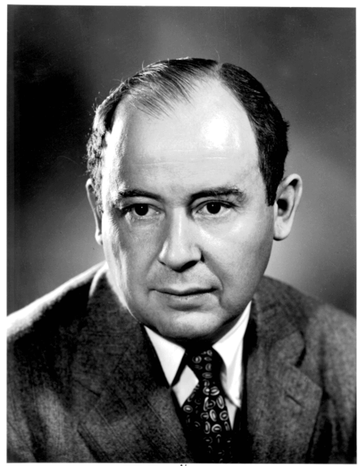
1.6 Computer hardware structure
Von Neumann Architecture
The five major units of the computer
Von Neumann

Slide 31
1.6.1 Von Neumann Architecture
The generation of the Van Neumann architecture ：
The earliest computers contained only fixed-purpose programs. These programs may be built directly with hardware, and the functionality of the program cannot be changed unless it is redesigned.
Van Neumann first proposed the idea of "storing" programs in computers.
Through the design of a set of instructions, the program becomes a process of execution of a series of instructions. At the same time, these sequences of instructions are stored in the computer's memory along with the data, so that the program can be easily modified as the data and executed under the existing hardware architecture
The concept of treating instructions as data has led to the birth of assembly languages and other higher-level languages, and the flexibility of program use has also been relatively improved.

Slide 32
1.6.1 Von Neumann Architecture
Problems and bottlenecks of Van Neumann's architecture ：
Since all software and data on a computer are stored in memory, if mistakes are made when designing and modifying programs, it is likely to cause damage to the operating system, programs, and data
In addition, because the Van Neumann architecture separates the CPU from memory, it creates the so-called Van Neumann bottleneck(Von Neumann bottleneck)
Retrieving data or instructions from memory is usually slower than CPU processing, so when a program needs to retrieve data from memory during execution, it can affect the overall performance of the program's execution.

Slide 33
1.6.2 The five major units of the computer
The five major units of computer hardware

Slide 34
Memory Unit
The memory unit is the place where the computer stores data and programs, and all the data required by the CPU is provided by memory, and the processing results are also stored back in memory first.
In addition to primary memory, which can be accessed randomly by the CPU, disks or optical drives are also considered memory components. These storage devices are also known as secondary memory or auxiliary memory

Slide 35
Memory Unit
Main memory is currently commonly referred to as "memory".
Main memory can be seen as a series of continuous storage spaces with the same structure, each space is identified by an address (address), and each byte (byte) will correspond to an address.
Memory is usually accessed in units of words (words), each with its own address, as long as the correct address is obtained, the required data can be accessed.

Slide 36
Input Unit
Computers are tools used by people to deal with problems, but to be delivered to computers to solve them, they must first be converted into digital data that can be interpreted by computers and input, and then computers can perform various calculations or processing.
The main function of the input unit is to read external programs and data and store them in the main memory.
Common input devices include keyboards, mice, drives, and optical drives.

Slide 37
Arithmetic & Logic Unit (ALU）
The Arithmetic and Logic unit is a part of a computer's central processing unit (CPU) that is responsible for performing various operations and processing data.
two most important tasks of ALU are arithmetic operations (addition, subtraction, multiplication and division) and logical operations （AND、OR、NOT）
The ALU is paired with a combination of high-speed memory called registers to perform various arithmetic and logical operations, and their access speed is synchronized with other CPU units, much faster than the main memory, so they can directly participate in ALU operations.

Slide 38
Arithmetic & Logic Unit(ALU）
Since the ALU is the place where the data is really processed, and the data in the processing process is all computed through registers, the ALU, registers, memory, and the data transmission channel between them are collectively referred to as the data path of the computer
The strength of computer computing power, the level of performance, and the number of functions are almost all determined by the arrangement of data paths

Slide 39
Output Unit
The output unit is responsible for taking the results of the central processing unit's operations out of the main memory and making them available to the user in various forms.
Common output devices include external storage (disks, optical discs, etc.), monitors, printers, speakers, plotters, networks, and other more diverse devices.

Slide 40
Control Unit(CU)
The control unit is composed of a bunch of control circuits scattered throughout the computer, responsible for the command, coordination, control, and decoding of instructions of the computer system.
The CU generates various timing signals to each unit according to the needs of the program instructions, so that each unit can complete the work it should complete at the right time to correctly implement the execution of various computer programs.

Slide 41
1.7 Instruction set The concept of a computer
Instruction Set Computer：
Reduced Instruction Set Computer(RISC）
Complex Instruction Set Computer(CISC）

Slide 42
RISC
Microprocessors only provide instructions with some simple basic functions.
Short instruction length, optimized design, and high clock frequency operation.
Each instruction in a high-level programming language must be composed of many simple machine instructions, therefore ：
It tests the software (such as compiler) design capabilities of manufacturers and system programmers.
Challenge how many times faster each simple instruction can be executed than complex instructions.
MIPS、ARM 、IBM RS series computers 、PowerPC 。

Slide 43
CISC
Microprocessor hardware itself provides instructions with powerful computing capabilities.
The instruction set is rich, the complexity is different, and it is not easy to optimize the design
Microprocessors provide a rich set of instructions for operating systems and applications, so the design of compilers is relatively simple.
Intel Pentium series CPU 、IBM Modern mainframe

Slide 44
1.8 Timeline of important development of modern computers
1946 （First generation） |  | ENIAC was invented, mainly made of vacuum tubes, and the program was executed in the form of a switch, capable of performing 5,000 addition/subtraction operations per second
1954 （2th generation） |  | The transistor was invented, and after that, computer development began to enter the second generation
1964 （3rd generation） |  | IBM launched the System/360 computer, which can work with 40 peripherals at the same time. In addition, the BASIC language has also developed successfully in this year, with the advantage of being easy to learn and easy to use. IBM's System/360 computer is also typical of the third generation of computers

Slide 45
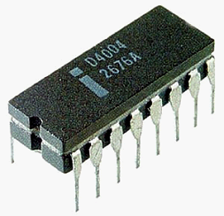
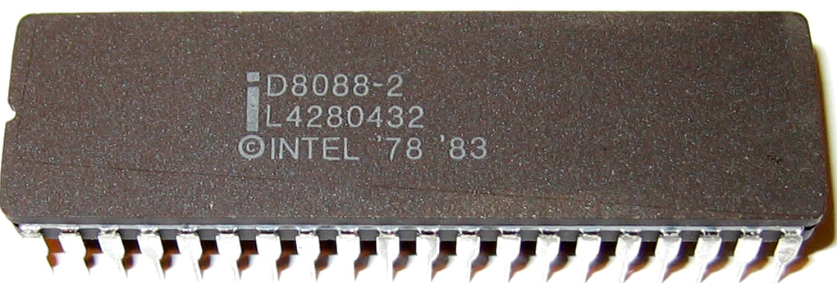
1.8 Timeline of important development of modern computers
1971 |  | Intel launched its first processor, the 4004, which had 2,250 transistors and could execute 60,000 lines of instruction per second
1974（Fourth generation） |  | Intel launched its first processor, the 4004, which had 2,250 transistors and could execute 60,000 lines of instruction per second
1976 |  | Steve Wozniak and Steve Jobs developed Apple I in San Francisco, USA, and founded Apple. A year later, the company launched the second-generation machine, the Apple II, which had I/O interfaces such as keyboards, cassettes, and game sticks, and was a very popular computer at the time

Slide 46
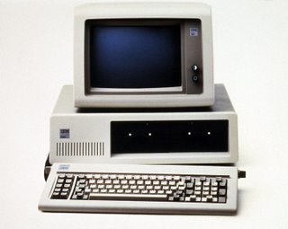
1.8 Timeline of important development of modern computers
1981 |  | IBM released the first personal computer using an Intel 8088 microprocessor with a clock frequency of 4.77 MHz and using the Microsoft MS-DOS operating system
1987 |  | IBM introduced the IBM PS/2 computer with a 3 1/2-inch floppy disk and VGA display. This model uses an Intel 80386 processor and can be controlled with a mouse for input

Slide 47
The Rise of RISC-V: Will It Replace x86 & ARM?
https://www.youtube.com/watch?v=tSdXBwZ84l0

